Slide 1
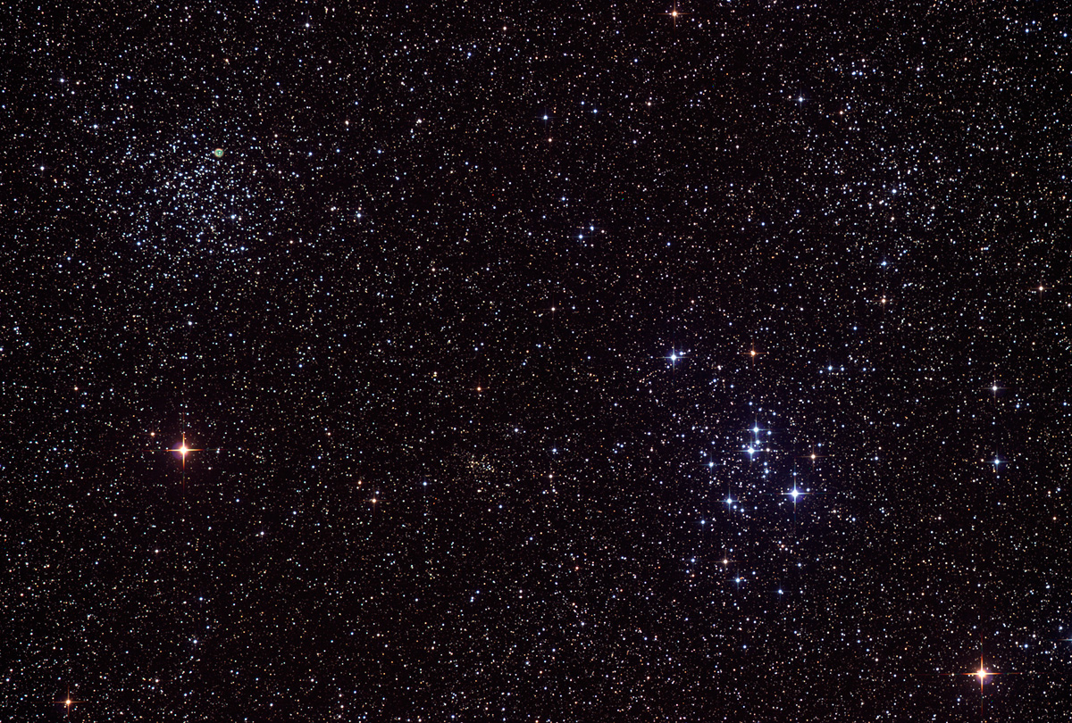

Howard
Astronomical
League
14
April 17th, 2014

Slide 2
Introductions

Slide 3
Upcoming club activities

Slide 4
Star Parties and public outreach!
April 24th-27th: Delmarva Stargaze
Tuckahoe State Park
April 26th: Members-only Star Party
May 10th: Public Star Party
May 24th: Members-only Star Party

Slide 5
Member’s astrophotos and sketches

Slide 6
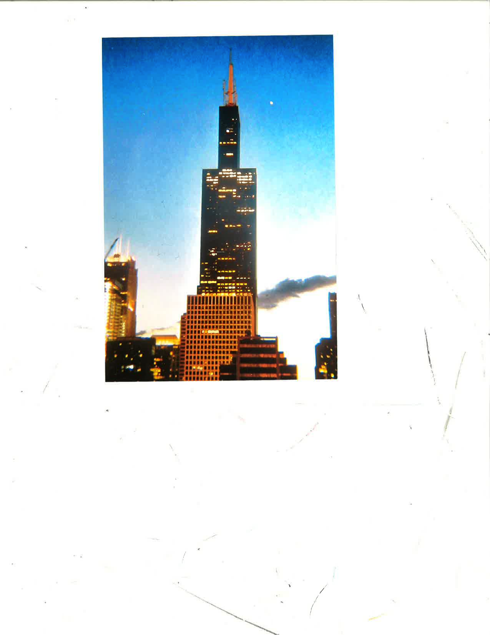
Herman Heyn
Notes:
Venus rising behind Chicago's Sears (now Willis!) Tower.
Morning photo taken in August of 2004.

Slide 7
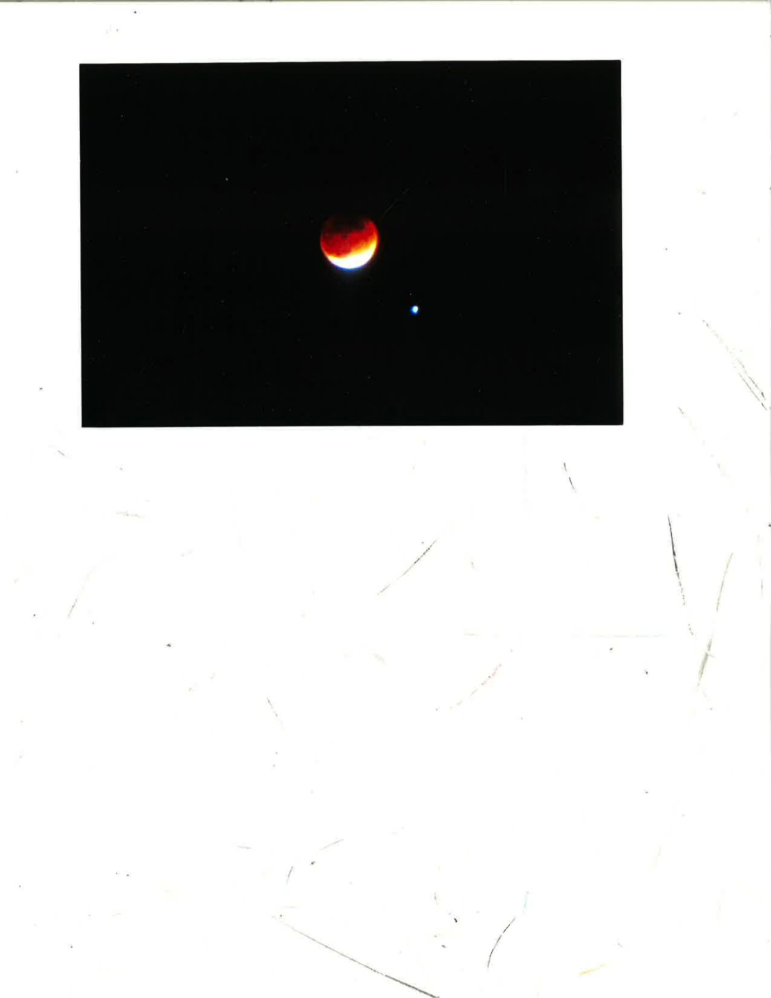
Herman Heyn
Notes:
THE LUNAR ECLIPSE WITH SPICA NONE OF US GOT TO SEE!
Actually, this is the eclipse of April 12, 1968.....46-years (16,804 days) ago!
I photographed it with my Pentax H1A with a Sears 135mm fixed telephoto lens
from my front yard in NW Baltimore. 5-sec. exposure @ f/3.5.
Pretty amazing clone, huh! Maybe a HAL can research the SAROS
connection between these two eclipses.

Slide 8
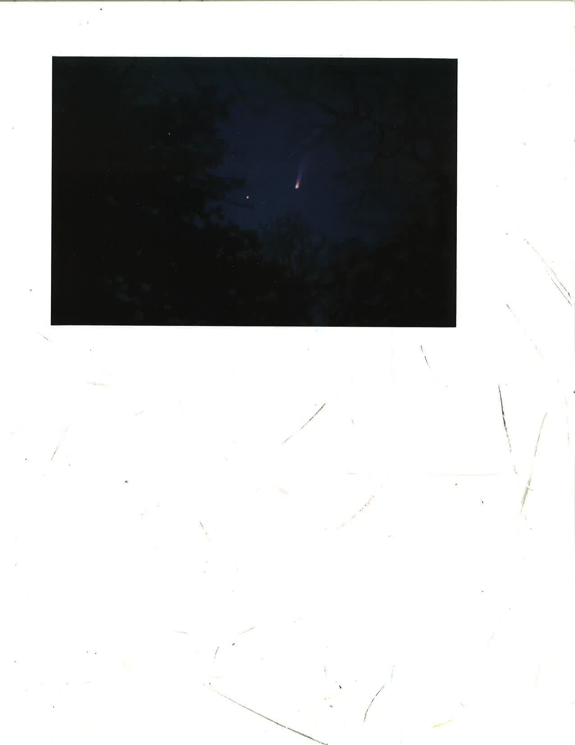
Herman Heyn
Notes:
Comet Bennett (1969i).
Photographed 04/04/1970 from my back yard in NW Baltimore.
Pentax H1A with 55mm lens (f/2.0).
My notes say it's slightly west of the Great Square of
Peg, but I don't recognize the stars.
Herman
P.S. Couldn't remove dust mote on scanner.

Slide 9
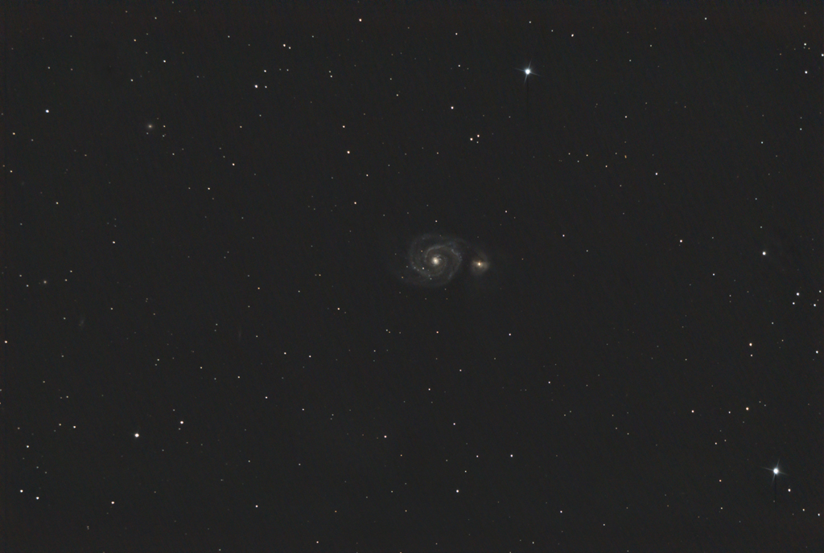
Mike Krauss

Slide 10
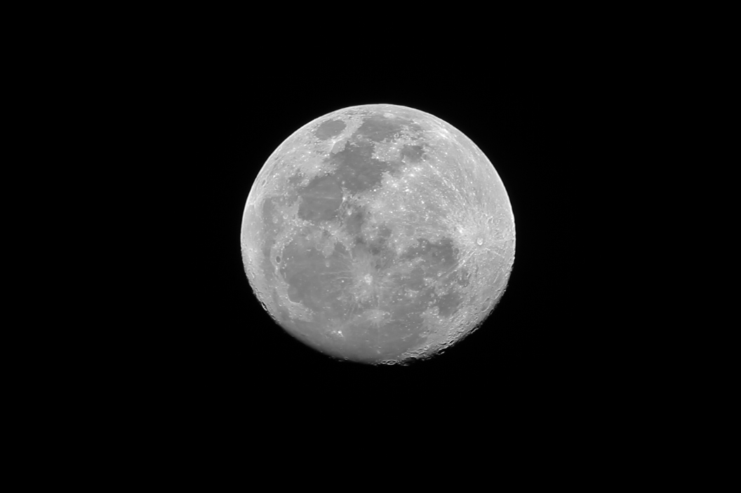
Mike Krauss

Slide 11
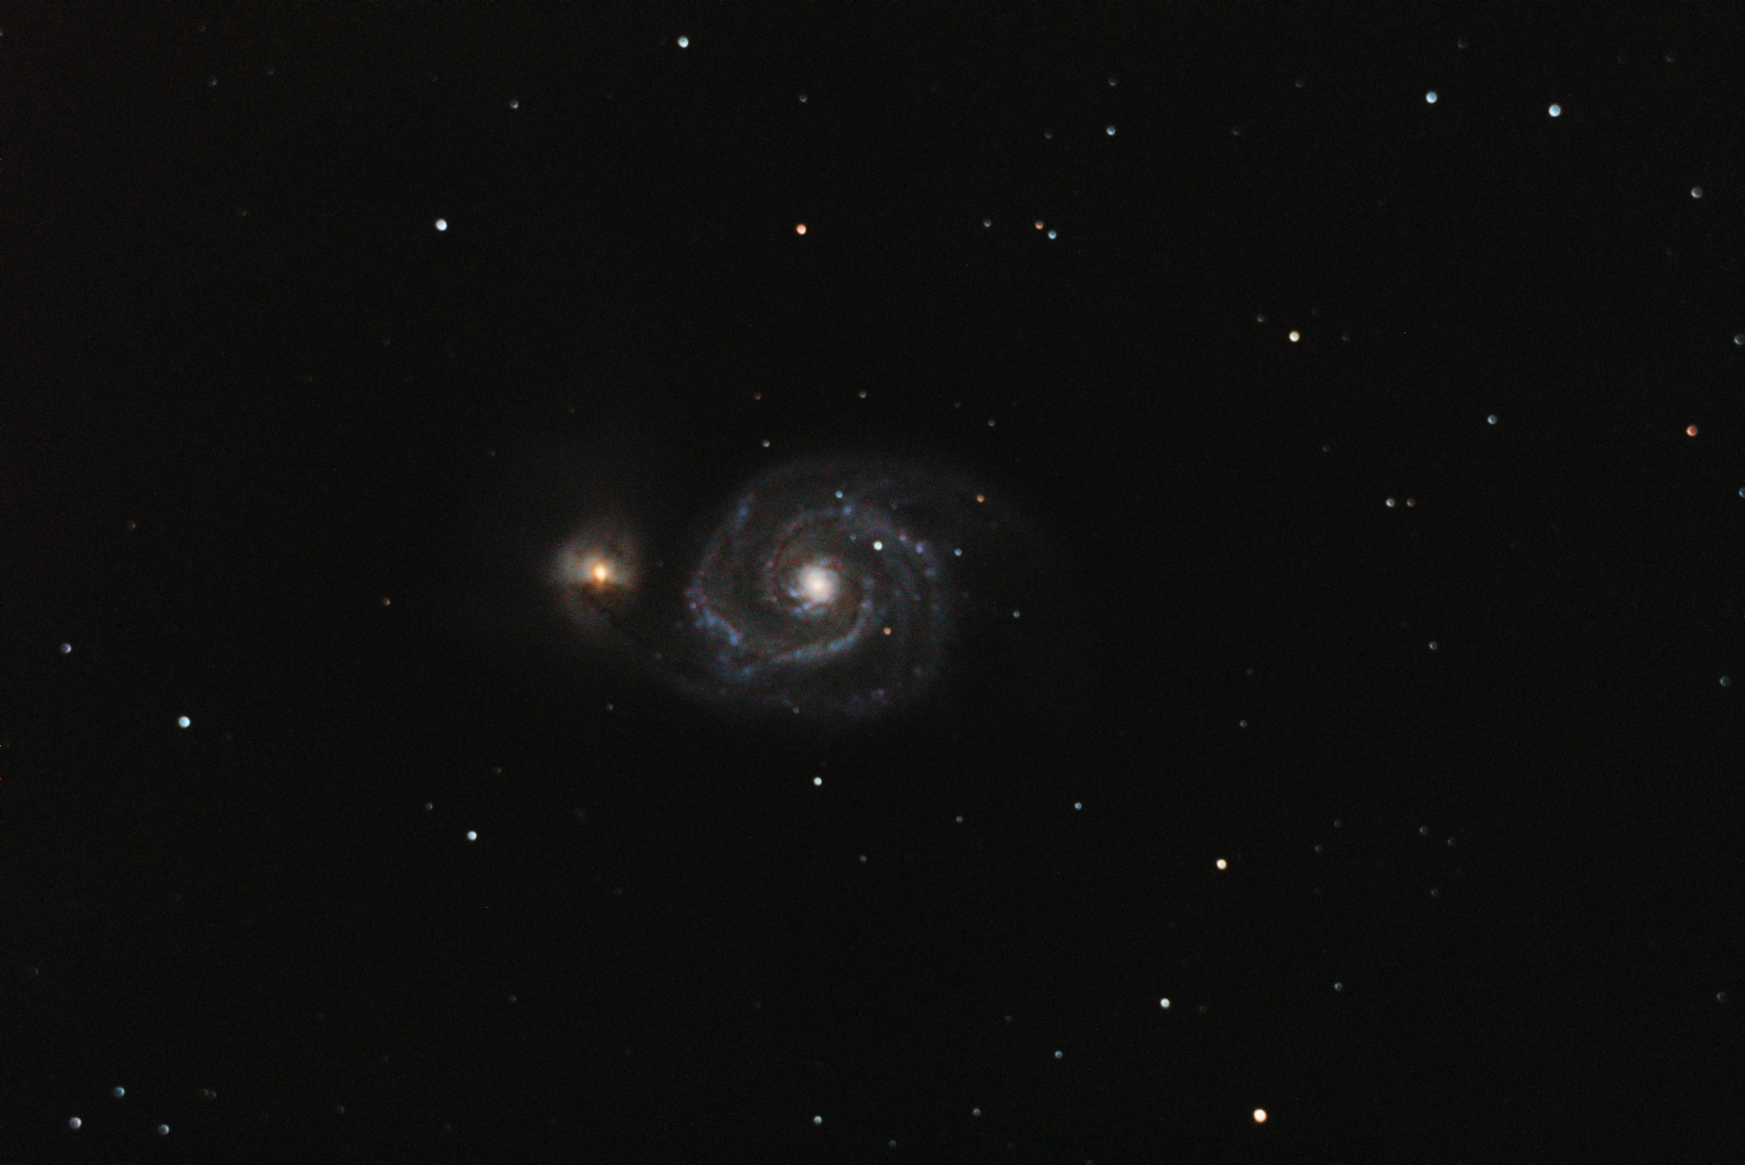
Victor Sanchez

Slide 12
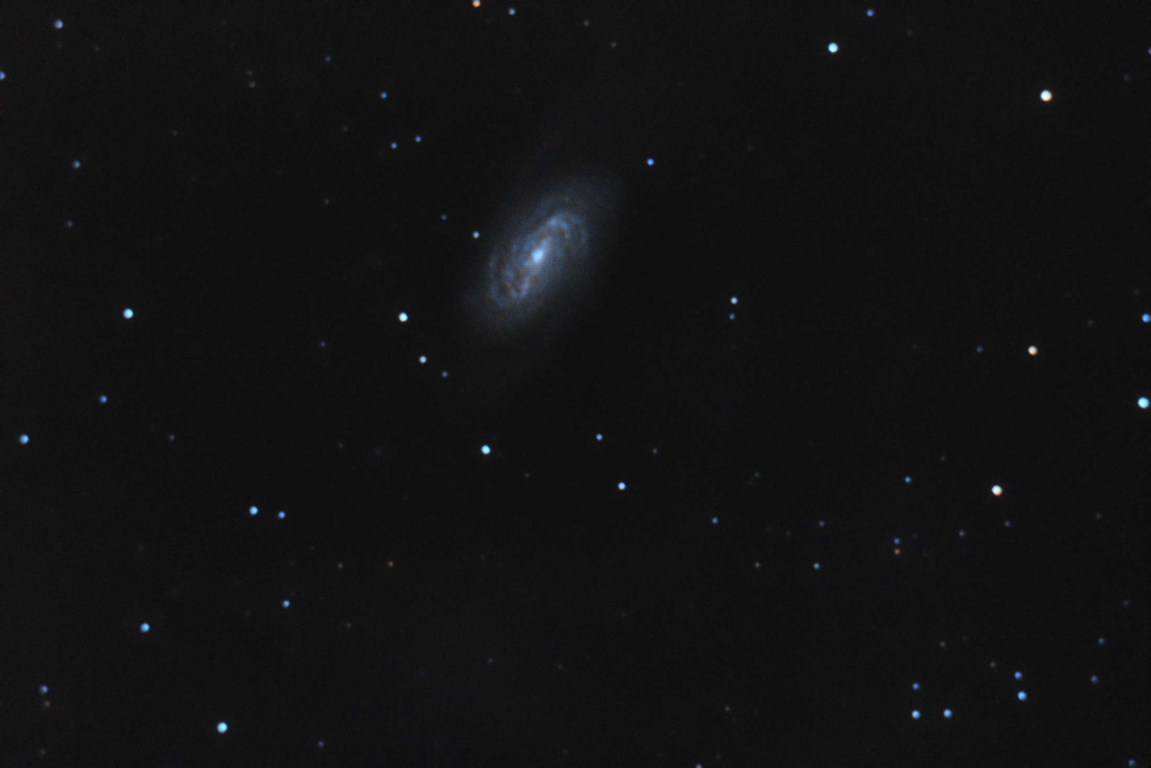
Victor Sanchez

Slide 13
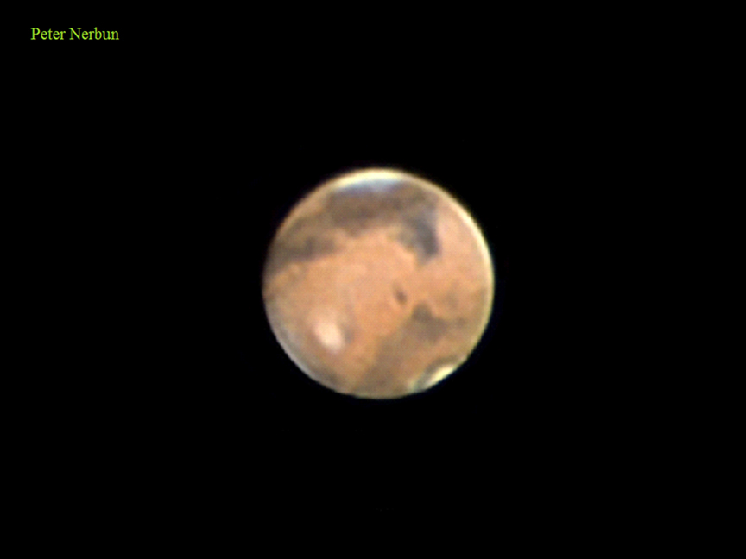

Slide 14
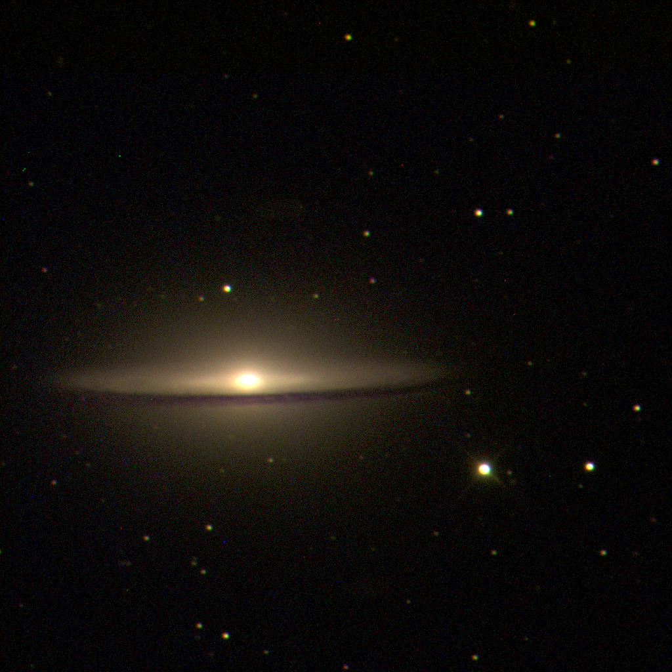
Joel Goodman

Slide 15
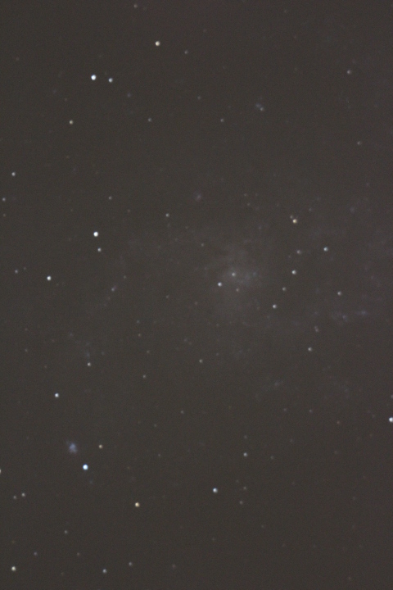
Gary Ingle
Notes:
M33? Or maybe M101?

Slide 16
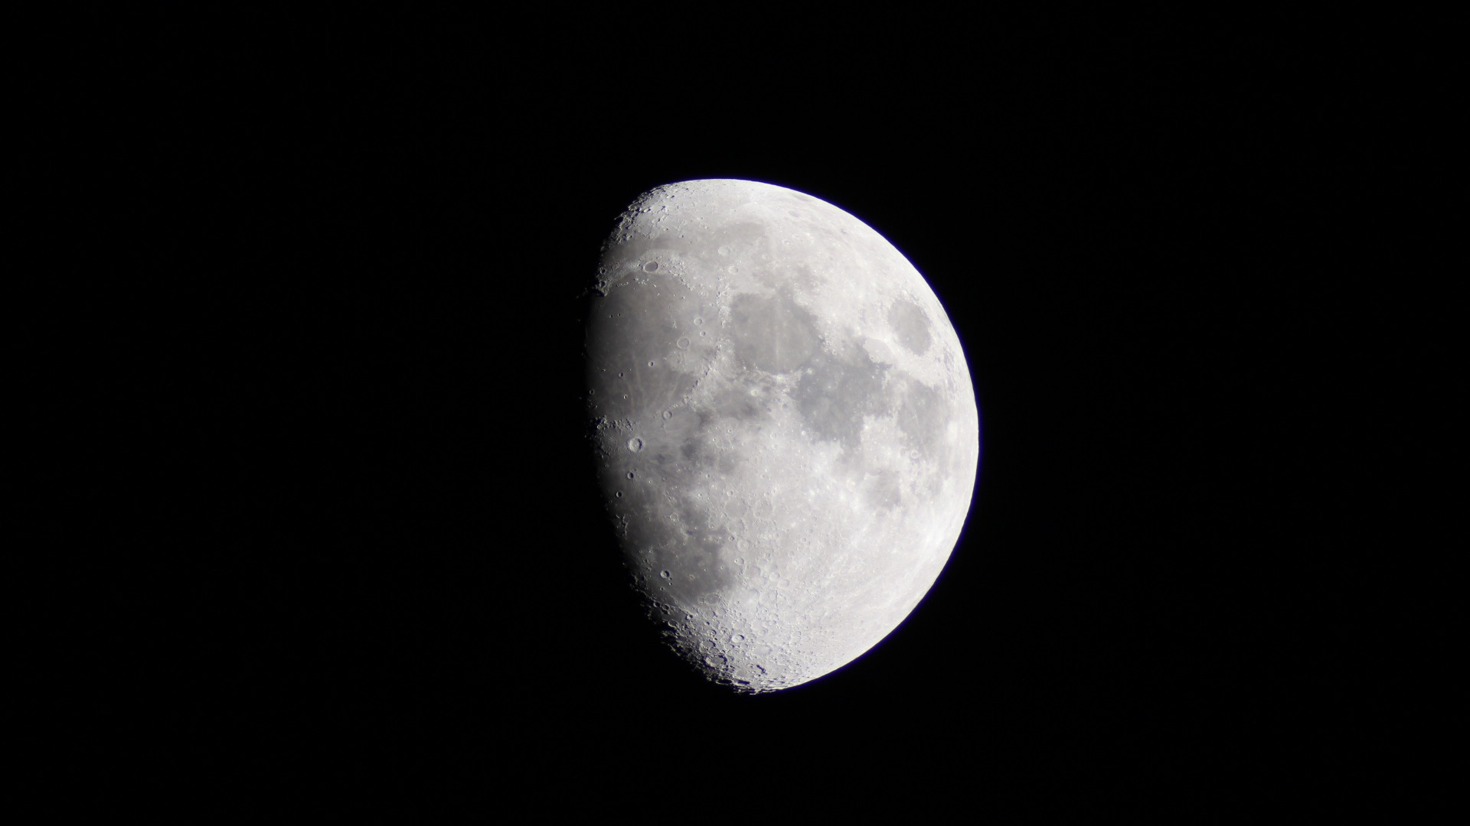
Gary Ingle

Slide 17
The Exoplanet Revolution
Dr. Brian Jackson
Notes:
BS in Physics, Georgia Institute of Technology, 2004
PhD in Planetary Sciences, U. Arizona, 2009
Postdoctoral fellow, Goddard Space Flight Center, 2009-2011
Postdoctoral fellow, Department of Terrestrial Magnetism, Carnegie Institute of Washington, 2011-present
Dr. jackson’s work focuses on orbital evolution and transit and eclipse observations of extrasolar planets. His research has helped show that extrasolar planets can lead rough lives and may experience violent deaths. His work on transit observations involves analysis of data from the Kepler mission to learn about planetary masses and atmospheres

Slide 18
Observatory update

Slide 19
Thank You!
Next month’s meeting is on Thursday,
May 15th, 2014 7:30 PM
Meeting Topic:
Joint meeting with Society of Women Engineers
(Equipment show and tell)
Socializing and equipment setup starting at 7 pm; no Astroschool

